Slide 1
TOPIC: Tell Us A Climate Story

Slide 2
Raising Awareness: Hackathons provide a platform to discuss and highlight the urgency of climate change issues, educating participants and the broader community.
Knowledge Sharing: Participants often learn about new technologies, data sources, and scientific research related to climate change.
Innovation and Solutions
Creative Problem-Solving: Hackathons encourage participants to think outside the box and develop innovative solutions to combat climate change.
Prototyping Ideas: Teams can quickly build prototypes of their solutions, which can lead to viable products or projects that may address climate issues

Slide 3
Collaboration and Networking
Interdisciplinary Collaboration: Hackathons bring together diverse groups, including programmers, scientists, designers, and policymakers, fostering collaboration across disciplines.
Networking Opportunities: Participants can connect with like-minded individuals, organizations, and potential mentors or investors.
Real-World Impact
Tangible Outcomes: Many projects developed during hackathons can be implemented in real-world scenarios, contributing to local or global climate initiatives.
Scalable Solutions: Ideas generated can often be scaled up or adapted for broader applications, increasing their potential impact.

Slide 4

Climate Change Overview
Climate Change: refers to long-term shifts in temperatures and weather patterns, primarily caused by human activities like burning fossil fuels, deforestation, and industrial processes.
Key Impacts of Climate Change:
Rising Temperatures: Global average temperatures have been steadily increasing, leading to more frequent and intense heatwaves.
Extreme Weather Events: Climate change is making extreme weather events more common and severe, including hurricanes, floods, droughts, and wildfires.
Melting Glaciers and Ice Sheets: The Earth's ice is melting at an alarming rate, contributing to rising sea levels and affecting coastal communities.
Ocean Acidification: As CO2 levels increase, the ocean's acidity is rising, threatening marine ecosystems and fisheries.

Slide 5
Python code for visual representation of climate change:
import matplotlib.pyplot as plt
# Sample
datayears = [2000, 2005, 2010, 2015, 2020, 2021]
average_temperatures = [14.0, 14.2, 14.5, 14.8, 15.1, 15.2]
co2_levels = [370, 379, 389, 403, 414, 416]
# Create a figure with two y-axes
fig, ax1 = plt.subplots(figsize=(10, 5))
# Plotting temperature
ax1.set_xlabel('Year’)
ax1.set_ylabel('Average Temperature (°C)', color='tab:red’)
ax1.plot(years, average_temperatures, color='tab:red', marker='o', label='Avg Temp’)
ax1.tick_params(axis='y', labelcolor='tab:red

Slide 6
# Create a second y-axis for CO2 levels
ax2 = ax1.twinx()
ax2.set_ylabel('CO2 Levels (ppm)', color='tab:blue’)
ax2.plot(years, co2_levels, color='tab:blue', marker='o', label='CO2 Levels’)
ax2.tick_params(axis='y', labelcolor='tab:blue’)
# Title and grid
plt.title('Climate Change Indicators Over Years’)
plt.grid()
plt.show()

Slide 7
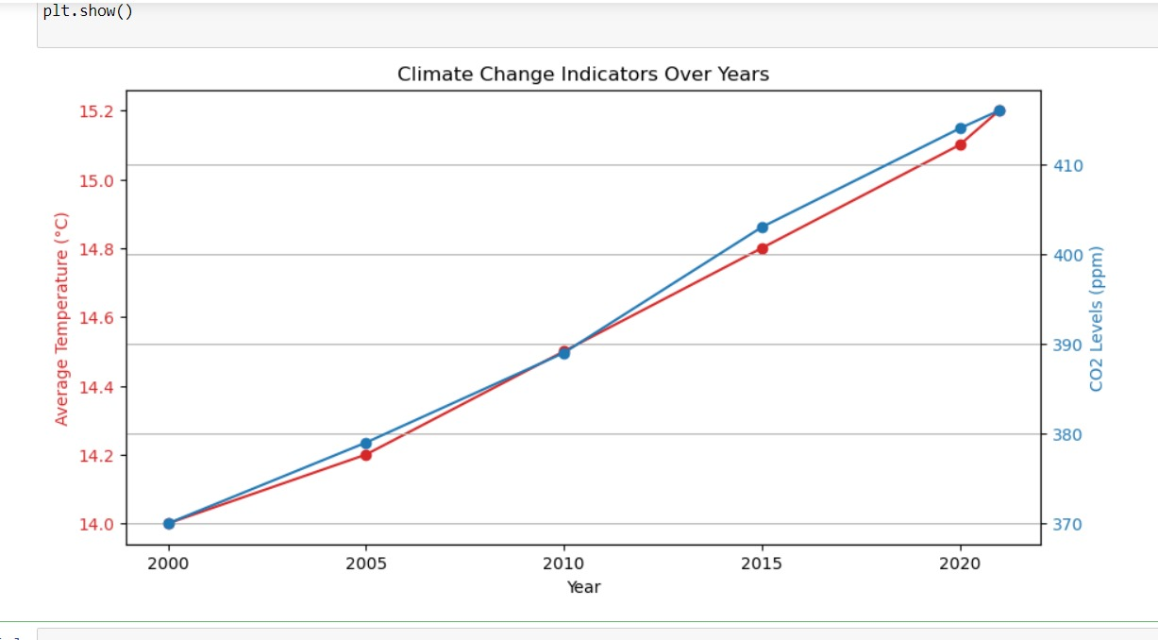
Output:

Slide 8
Sample Dataset
Here's a small, simplified dataset showing global average temperatures and CO2 levels over a few selected years:
| Year | Average Temperature (°C) | CO2 Levels (ppm) |
|------|--------------------------|-------------------|
| 2000 | 14.0 | 370 |
| 2005 | 14.2 | 379 |
| 2010 | 14.5 | 389 |
| 2015 | 14.8 | 403 |
| 2020 | 15.1 | 414 |
| 2021 | 15.2 | 416 |

Slide 9
Simple Explanation of the Data
Year: The specific year for the measurements.
Average Temperature: This is the global average temperature, showing a trend of increasing warmth.
CO2 Levels: This represents the concentration of carbon dioxide in the atmosphere, measured in parts per million (ppm). An increase in CO2 levels correlates with rising temperatures.

Slide 10
Natural Methane Emissions:
GOSAT-based Top-down Total and Natural Methane EmissionsTotal and natural methane emissions derived using the GEOS-Chem global chemistry transport model with inclusion of GOSAT data. Methane emission values for both before and after adding GOSAT to the model are mapped to a 1° resolution grid.
Key sources of natural methane emissions:
Wetlands: These ecosystems, characterized by waterlogged soils, are significant contributors. Microorganisms in these environments decompose organic matter, producing methane as a byproduct.
Termites: These insects release methane during their digestive processes. Their activities in tropical and subtropical regions contribute to the global methane budget.
Hydrates: Methane hydrates are crystalline solids formed under high pressure and low temperature conditions. They are found in deep ocean sediments and permafrost. As temperatures rise, these hydrates can destabilize, releasing methane into the atmosphere.

Slide 11
Python code for visual representation of natural methane emissions:
import matplotlib.pyplot as plt
# Sample data
regions = ['Region1', 'Region2', 'Region3’]
bottom_up_emissions = [100, 150, 200]
top_down_emissions = [95, 145, 180]
# Bar width
bar_width = 0.35
x = range(len(regions))
# Create the bar plot
plt.figure(figsize=(10, 6))

Slide 12
# Bottom-up emissions
plt.bar(x, bottom_up_emissions, width=bar_width, label='Bottom-Up Emissions', color='b', align='center’)
# Top-down emissions
plt.bar([p + bar_width for p in x], top_down_emissions, width=bar_width, label='Top-Down Emissions', color='r', align='center’)
# Add labels and title
plt.xlabel('Regions’)
plt.ylabel('Methane Emissions (tons)’)
plt.title('Comparison of Methane Emissions: Bottom-Up vs. Top-Down’)
plt.xticks([p + bar_width / 2 for p in x], regions)
plt.legend()
# Show the plot
plt.tight_layout()
plt.show()

Slide 13
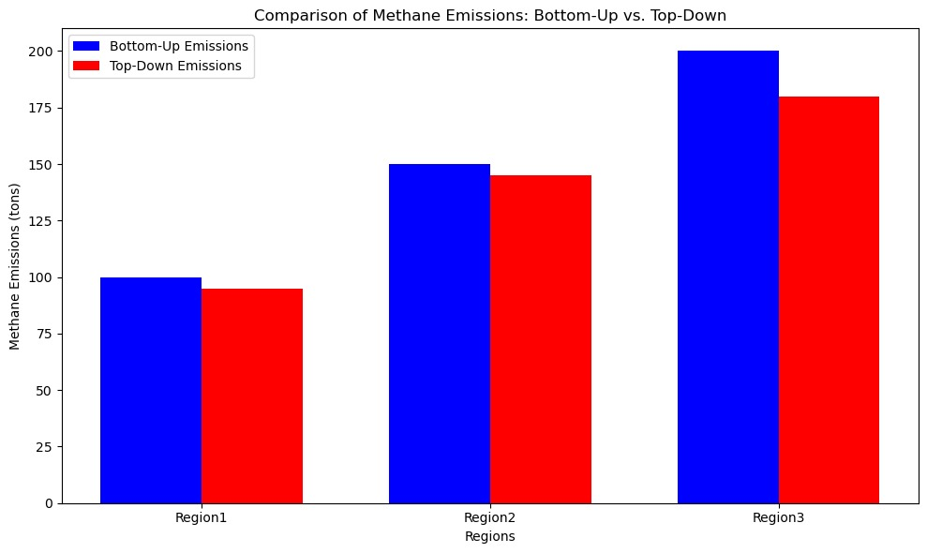
Output:

Slide 14
Mitigation Resources
IPCC Reports:The Intergovernmental Panel on Climate Change (IPCC) provides comprehensive assessments of climate change, including mitigation strategies.IPCC Special Reports (e.g., SR15 on limiting global warming to 1.5°C).United Nations Framework Convention on Climate Change (UNFCCC):Offers guidance and resources on climate action, including emissions reduction strategies.UNFCCC Mitigation Resources
Adaptation Resources
National Adaptation Forum:Focuses on sharing information about climate adaptation strategies and practices.National Adaptation ForumIPCC Adaptation Resources:Similar to mitigation, the IPCC provides insights and assessments on adaptation strategies in its reports.IPCC Adaptation Reports

Slide 15
General Resources
Climate.gov:Provides a range of educational resources on climate science and impacts, including mitigation and adaptation.Climate.govC40 Cities:Focuses on climate action in cities, offering resources and strategies for urban adaptation and mitigation.C40 Cities Resources
Academic Journals
Climate Policy:A journal focusing on policy responses to climate change, including mitigation and adaptation strategies.Climate Policy JournalGlobal Environmental Change:Publishes research on the interactions between environmental change and human society.Global Environmental Change Journal

Slide 16
Mitigation Solutions
Transition to Renewable Energy:
Implementation: Shift from fossil fuels to renewable energy sources like solar, wind, and hydroelectric power.Action: Invest in renewable energy infrastructure and incentivize the adoption of clean energy technologies.
Energy Efficiency Improvements:
Implementation: Enhance energy efficiency in buildings, transportation, and industries.Action: Implement energy efficiency standards, promote energy-saving technologies, and provide incentives for energy-efficient appliances.
Adaptation Solutions
Climate-Resilient Infrastructure:
Implementation: Design and build infrastructure that can withstand climate impacts (e.g., flooding, heatwaves).
Action: Upgrade existing infrastructure and incorporate climate risk assessments in planning.

Slide 17
Ecosystem Restoration:
Implementation: Restore degraded ecosystems (e.g., wetlands, forests) to enhance natural resilience.Action: Invest in reforestation and wetland restoration projects.
Integrated Solutions
Policy Development:
Implementation: Develop comprehensive policies that integrate mitigation and adaptation strategies.Action: Create a national or regional climate action plan that includes specific targets and actions for both areas.
Research and Innovation:
Implementation: Invest in research to develop new technologies and practices that support both mitigation and adaptation.
Action: Collaborate with universities, research institutions, and the private sector to advance climate solutions.

Slide 18
Python code:
import matplotlib.pyplot as plt
# Define the categories and their corresponding number of solutions
categories = ['Mitigation', 'Adaptation’]
num_solutions = [6, 6]
# Number of solutions in each category
# Create a bar chart
plt.figure(figsize=(8, 5))
plt.bar(categories, num_solutions, color=['blue', 'green’])
plt.title('Number of Solutions for Climate Change’)
plt.ylabel('Number of Solutions’)
plt.xlabel('Categories’)
plt.ylim(0, 8)

Slide 19
# Display the values on top of the bars
for i, value in enumerate(num_solutions):
plt.text(i, value + 0.1, str(value), ha='center’)
# Show the plot
plt.tight_layout()
plt.show()
# Brief summary of solutions
print("Mitigation Solutions (Key Points):")
print("1. Transition to Renewable Energy")
print("2. Energy Efficiency Improvements")
print("3. Sustainable Transportation")
print("4. Agricultural Practices")

Slide 20
print("5. Waste Management")
print("6. Carbon Pricing\n")
print("Adaptation Solutions (Key Points):")
print("1. Climate-Resilient Infrastructure")
print("2. Ecosystem Restoration")
print("3. Water Resource Management")
print("4. Disaster Preparedness and Response")
print("5. Climate-Smart Agriculture")
print("6. Community Engagement and Education")

Slide 21
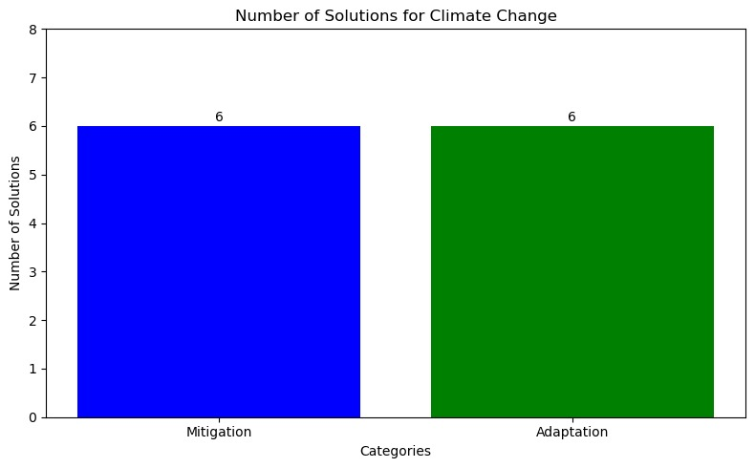
Output:

Slide 22
import pandas as pd
file_path=r"C:\Users\Ayesha\Downloads\climate_story.csv“
df=pd.read_csv(file_path)print(df.columns)
Index(['Year', 'Avg_Temperature (°C)', 'CO2_Level (ppm)', 'Sea_Level_Rise (mm)', 'Extreme_Events'], dtype='object’)
print(df.describe())
Year Avg_Temperature (°C) CO2_Level (ppm) \count 6.000000 6.000000 6.000000 mean 2012.166667 14.916667 395.000000 std 8.841191 0.348807 18.536451 min 2000.000000 14.500000 370.000000 25% 2006.250000 14.650000 382.500000 50% 2012.500000 14.900000 395.000000 75% 2018.750000 15.150000 409.000000 max 2023.000000 15.400000 418.000000 Sea_Level_Rise (mm) Extreme_Events count 6.000000 6.000000 mean 3.150000 22.000000 std 0.766159 8.921883 min 2.100000 12.000000 25% 2.625000 15.750000 50% 3.200000 20.000000 75% 3.700000 28.000000 max 4.100000 35.000000

Slide 23
import matplotlib.pyplot as plt
# Assuming 'Year' and 'CO2_Level (ppm)' columns exist
plt.figure(figsize=(12, 6))
plt.plot(df['Year'], df['CO2_Level (ppm)'], marker='o’)
plt.title('CO2 Levels Over Years’)
plt.xlabel('Year’)
plt.ylabel('CO2 Levels (ppm)’)
plt.grid()
plt.show()

Slide 24
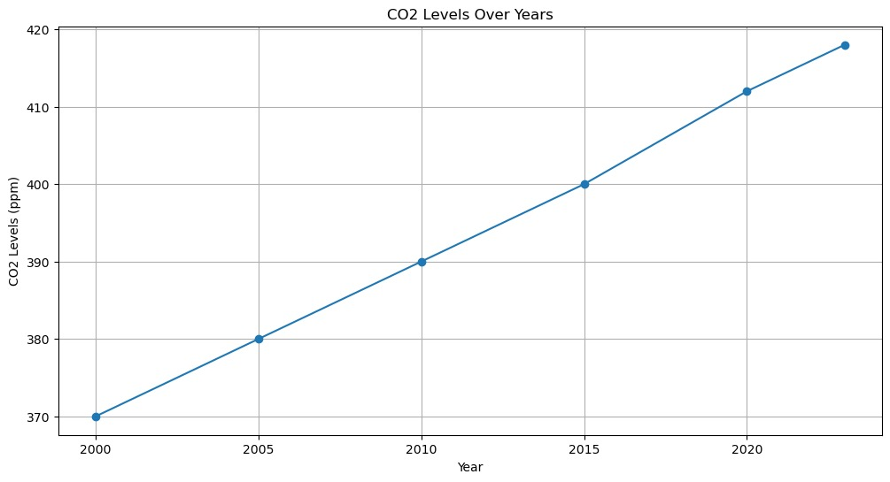

Slide 25
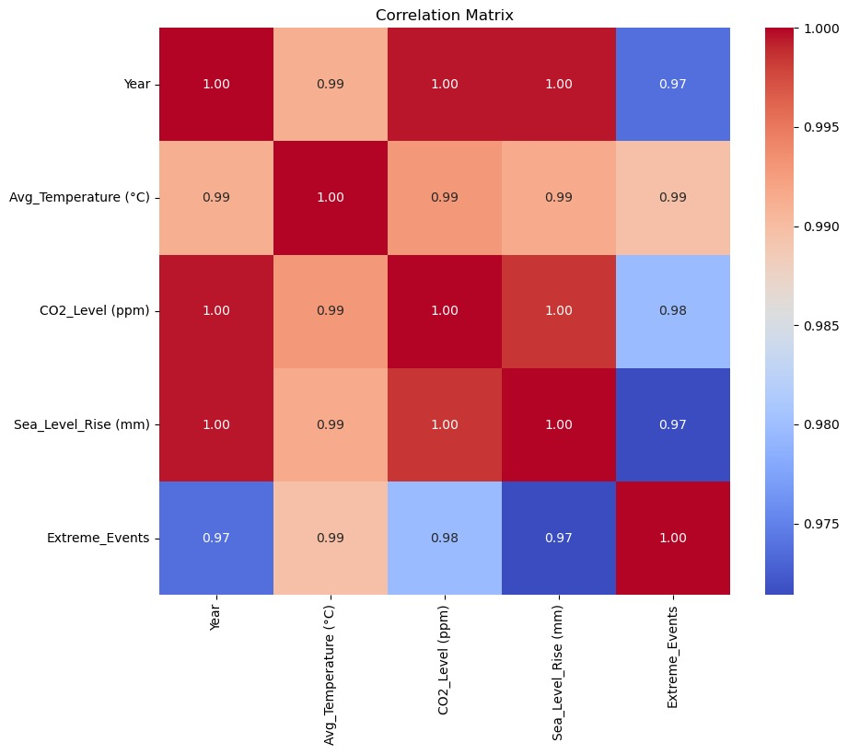
import seaborn as sns
plt.figure(figsize=(10, 8))
correlation_matrix = df.corr()
sns.heatmap(correlation_matrix, annot=True, cmap='coolwarm', fmt=".2f")
plt.title('Correlation Matrix’)
plt.show()

Slide 26
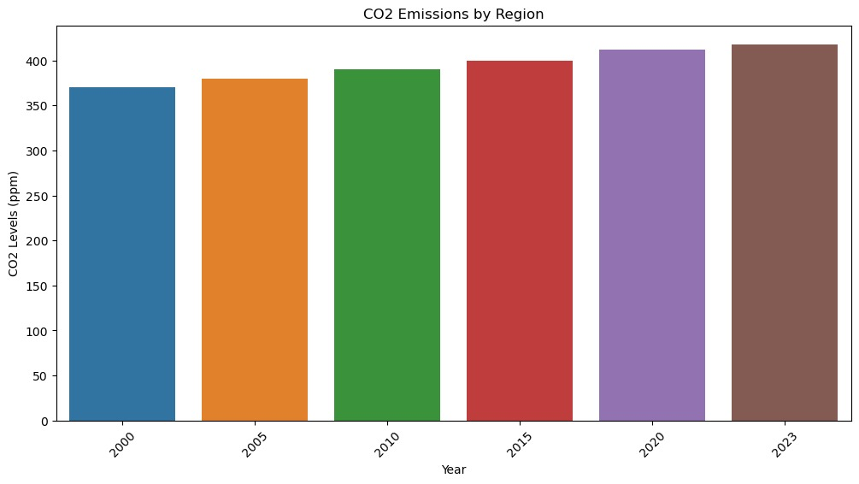
# Assuming you have a 'Year' columnregion_emissions = df.groupby('Year')['CO2_Level (ppm)'].sum().reset_index()
plt.figure(figsize=(12, 6))
sns.barplot(data=region_emissions, x='Year', y='CO2_Level (ppm)’)
plt.title('CO2 Emissions by Region’)
plt.xlabel('Year’)
plt.ylabel('CO2 Levels (ppm)’)
plt.xticks(rotation=45)
plt.show()

Slide 27
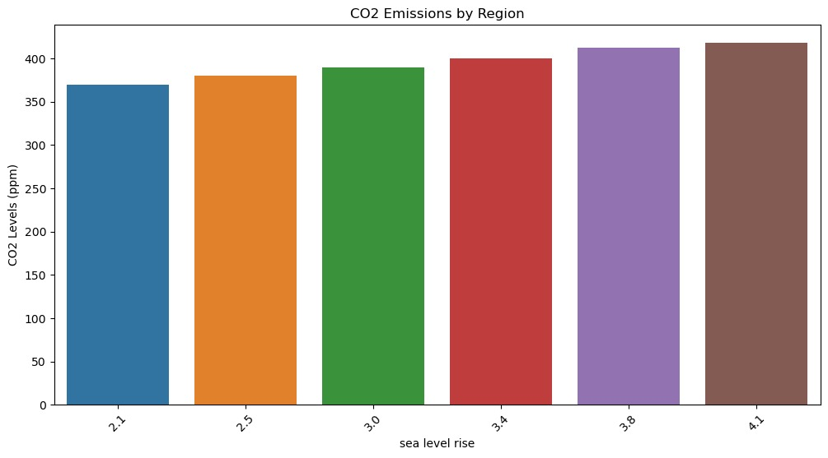
# Assuming you have a 'SEA_LEVEL_RISE' columnregion_emissions = df.groupby('Sea_Level_Rise (mm)')['CO2_Level (ppm)'].sum().reset_index()
plt.figure(figsize=(12, 6))
sns.barplot(data=region_emissions, x='Sea_Level_Rise (mm)', y='CO2_Level (ppm)’)
plt.title('CO2 Emissions by Region’)
plt.xlabel('sea level rise’)
plt.ylabel('CO2 Levels (ppm)’)
plt.xticks(rotation=45)
plt.show()

Slide 28
# Example: Filter years with high CO2 emissions
high_emissions = df[df['CO2_Level (ppm)'] > 400]
# Adjust threshold as needed
print(high_emissions)
Year Avg_Temperature (°C) CO2_Level (ppm)
Sea_Level_Rise (mm) \4 2020 15.2 412 3.8 5 2023 15.4 418 4.1 Extreme_Events 4 30 5 35
import matplotlib.pyplot as plt
# Actions and their corresponding CO2 reduction in metric tons per yearactions = ['Using Solar Panels', 'Using Public Transport', 'Energy Efficient Appliances', 'Planting Trees', 'Reducing Meat Consumption’]
co2_reduction = [2.5, 1.8, 1.0, 0.5, 0.4]
# Estimated CO2 reduction in metric tons per year
# Create the bar chart
plt.bar(actions, co2_reduction, color=['green', 'blue', 'orange', 'purple', 'red'])

Slide 29
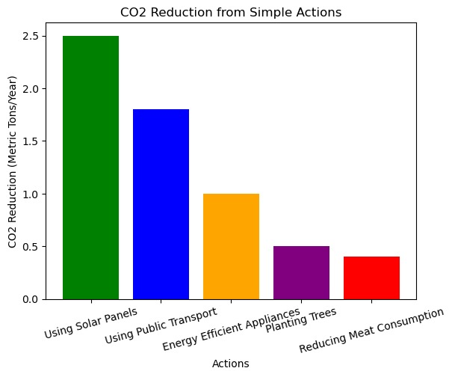
# Adding a title and labels
plt.title('CO2 Reduction from Simple Actions’)
plt.xlabel('Actions’)
plt.ylabel('CO2 Reduction (Metric Tons/Year)’)
# Rotate the x-axis labels for better readability
plt.xticks(rotation=15)
# Display the chart
plt.show()

